Slide 1

StudytoShine.com
Log-In Flow
- Take charge of your learning

Slide 2
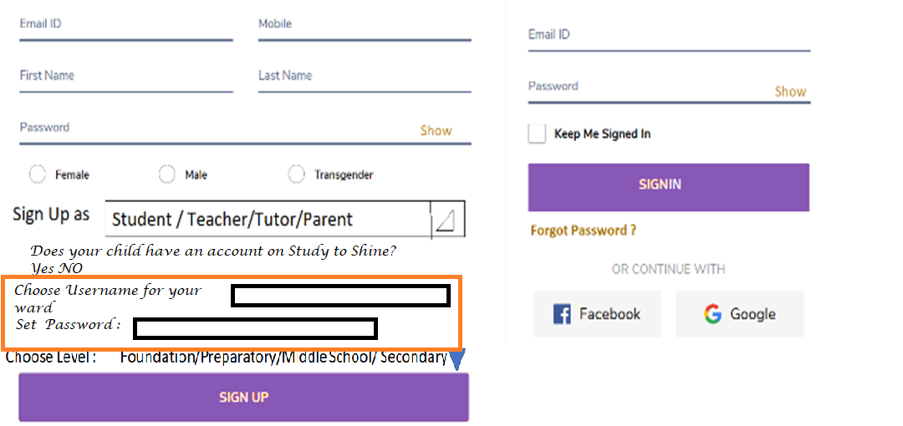


Proposed Login form

Slide 3
Types of Users and Access characteristics
Description of Levels that the content on the website will ascribe to : Level Class
Foundation : Pre school , I, II
Preparatory : III, IV, V
Middle School : VI, VII, VIII
Secondary : IX, X, XI, XII
Types of Users :
Student
Teacher/Tutor
Parent
Access characteristics:
Every user will have a personal dashboard with respect to the type of login.
The content inside I Assess will be accessible only when the user logs in.
Even if the user logins through Single Sign On (SSO) through “Account Settings” the following details need to be filled :
-> Role (Student/Teacher /Tutor/Parent)
--> Date of Birth
-> Level (Foundation, Preparatory, Middle School, Secondary)

Slide 4

Login Flow
Gets a personal dashboard with respect to role.
Display a bell icon besides the user name in the header.
Can access all features of “ I Assess” option.
Level of the User will be highlighted.
Learning content will be displayed in the content pane with respect to the level selected.
Add to “My Course List” will be activated
Test your learning option with each course will be activated.
Login
Yes
No
Can Access the full Website and the worksheet generator option inside “I Assess “ option.

Slide 5
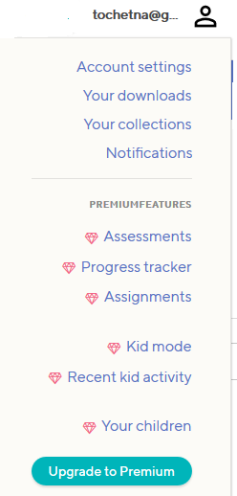









Dashboard Components
Student
Teacher/Tutor
Parent
My Account
My Calendar
My Course list
My Learning
- Set Targets
- My Progress
Self Assessment
My Performance Report
My Account
My Calendar
My Class
- Create
- Edit
- Delete
My Course List
My Class’ Learning
- Set Target
- Class’ Progress
Assessment
My Class’ Performance Report
My Account
My Calendar
My Course List
My Child’s Learning
- Set Targets
Assessment
My Child’s Performance Report

Slide 6

















Sample Web page
Sign in
Study to Shine.com
- Take charge of your learning
Search By
I Learn
I Enjoy
I am Aware
I Excel
I Assess
My Country My Pride
Choose Level
I Learn-> Foundation -> Mathematics -> Numbers
Foundation
Preparatory
Skip Counting
Middle School
Secondary
Education
Topics (3)
Add to “My Course List”
Test your learning
If the user Signs In then
Add to “My Course List” and “Test Your Learning” shall be activated.
Subject
English
Hindi
Maths
EVS

Slide 7
Common Features of User Login (Description)

Slide 8
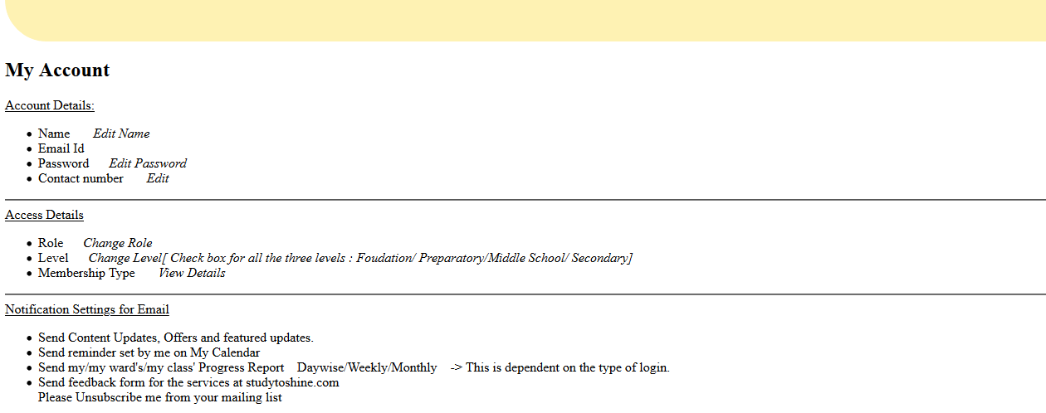







My Account
This feature shall allow user to access account settings.
In case of Parent ,
Child’s user name :
Child Password :
Add more +
Shall also be added

Slide 9
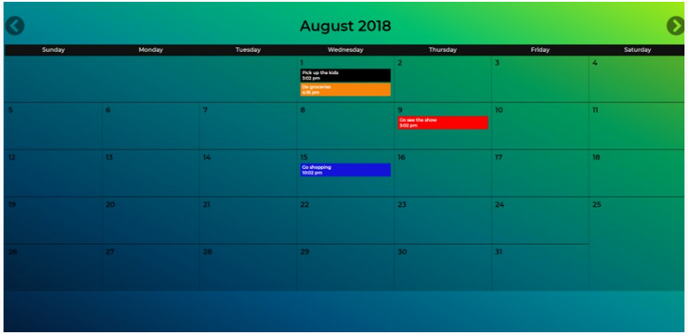




My Calendar
Features & Requirements:
Ability to add a new "reminder" (max 30 chars) for a user entered day and time
Display reminders on the calendar view in the correct time order
Allow the user to select a colour when creating a reminder and display it appropriately
Properly handle overflow when multiple reminders appear on the same date
Ability to edit reminders – including changing text, day and time & colour
Ability to delete reminders
Expand the calendar to support more than current month
The bell icon should be highlighted on the day of the reminder and on clicking it a context menu should be displayed containing the “reminder”.
Reference : https://reactjsexample.com/build-a-fully-functional-calendar-with-reminders-using-react-and-redux/

Slide 10
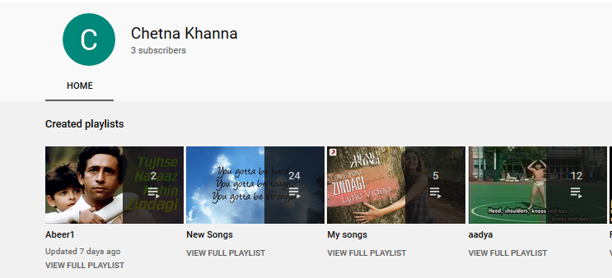
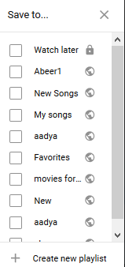
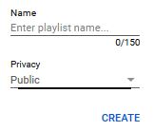


My Course List
This feature shall contain list of videos added to the course list by the user as in YouTube.
Working :
Add to “My Course List” option shall be visible for all the videos and Courses in case of login.
On clicking it a context menu resembling YouTube should be displayed:

Slide 11
Features of Student Login (Description)

Slide 12

























My Learning -> Set Target
Set Start Date :
Set End Date :
Send Reminder : ___ days before End Date
Set Start Date :
Set End Date :
Send Reminder : ___ days before End Date
Set Start Date :
Set End Date :
Send Reminder : ___ days before End Date
Set Target
Set Target
Set Target

Slide 13
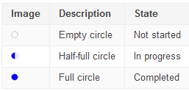



























My Learning -> My Progress
Pie chart shall also be generated
Reference : https://edu.google.com/openonline/course-builder/docs/1.10/for-course-builder-developers/specific-sub-tasks/student-progress.html

Slide 14










Self Assessment
Add to my Test plan
Add to my Test plan
Add to my Test plan
Take Test
Take Test
Take Test
Abeer1
My Songs
Will the test be time bound?
Test Plan
Yes
No
Take test Now?
Yes
No
Set start Date:
Set end Date:
Invite your friends:
(By Email Id)
Do you want to receive notification?
Yes
No
About US
Contact Us

Slide 15




















My Performance Report
Hi Name
You have
Completed ___ videos.
Taken Test for ______
You need to take ____ more tests to solicit your learning. (Completed videos – Test Taken)
Your scores are :
Test Topic(s) Max. Marks Marks Obtained % Distribution of marks obtained Remarks
Easy Medium Difficult

Slide 16
Features of Teacher Login (Description)

Slide 17



















My Class
Hi Name !
You have not created a class yet.
Create a Class:
Choose Class : 1- 12
Enter Label :
Enter Number of Students:
Send Invite :
Enter Name Email Id :
_________ __________ +
Or Upload Excel file in the following format:
Name Email id
Create
Hi Name !
Your Class details
III – A Edit / Delete
IV – B Edit/ Delete
Wed 9 -5 Edit /Delete
Create a New Class
Name | Email id | Edit
Vrinda | rr@ee.com | Edit
+ Add more

Slide 18
Set Target
Set Start Date :
Set End Date :
Send Reminder : ___ days before End Date
Assign :
Set Start Date :
Set End Date :
Send Reminder : ___ days before End Date
Assign :
Set Start Date :
Set End Date :
Send Reminder : ___ days before End Date
Assign:
Set Target
Set Target
Set Target

Slide 19




Feature Description : My Class’ Progress
Pie chart shall also be generated
Reference : https://edu.google.com/openonline/course-builder/docs/1.10/for-course-builder-developers/specific-sub-tasks/student-progress.html

Slide 20


Feature Description : Assessment
Add to my Test plan
Add to my Test plan
Add to my Test plan
Take Test
Take Test
Take Test
Abeer1
My Songs
Will the test be time bound?
Test Plan
Yes
No
Take test Now?
Yes
No
Set start Date:
Set end Date:
Do you want to receive notification?
Yes
No

Slide 21

















My Class’ Performance Report
Choose Class :
Topic(s) | Name | Max Marks | Marks Obtained | Send mail
Do you want to take a remedial action ?
Yes
No
List contains students with Marks <=
__%
Send a retest Link

Slide 22
Features of Parent Login (Description)

Slide 23
Set Target
Set Start Date :
Set End Date :
Send Reminder : ___ days before End Date
Assign :
Set Start Date :
Set End Date :
Send Reminder : ___ days before End Date
Assign :
Set Start Date :
Set End Date :
Send Reminder : ___ days before End Date
Assign:
Set Target
Set Target
Set Target

Slide 24
My Ward’s Progress
Pie chart shall also be generated
Reference : https://edu.google.com/openonline/course-builder/docs/1.10/for-course-builder-developers/specific-sub-tasks/student-progress.html

Slide 25
Assessment
Add to my Test plan
Add to my Test plan
Add to my Test plan
Take Test
Take Test
Take Test
Abeer1
My Songs
Will the test be time bound?
Test Plan
Yes
No
Take test Now?
Yes
No
Set start Date:
Set end Date:
Child’s email id in case the child has an account or Username chosen by the parent while registering.
Do you want to receive notification?
Yes
No

Slide 26
My Ward’s Progress Report
Hi Parent Name
Your ward has,
Completed ___ videos.
Taken Test for ______
You need to take ____ more tests to solicit your learning. (Completed videos – Test Taken)
Your scores are :
Test Topic(s) Max. Marks Marks Obtained % Distribution of marks obtained Remarks
Easy Medium Difficult

